Slide 1







Most used Languages and Databases
Alexa Long
July 2023

Slide 2



OUTLINE
Executive Summary
Introduction
Methodology
Results
Visualization – Charts
Dashboard
Discussion
Findings & Implications
Conclusion
Appendix

Slide 3

EXECUTIVE SUMMARY
Current Coding Language Trends
Future Language Trends
Current Database Trends
Future Database Trends

Slide 4

INTRODUCTION
This report is about the top used coding languages and databases
The data obtained from this report was given by those that work with these languages and databases at their place of work
This report is for others in the field who want to keep up with the current trends
The reader will gain insight into current trends and future trends

Slide 5

METHODOLOGY
Data was collected through research and surveys
That data was then put into multiple python notebooks
The data was there cleaned and analyzed
Visualizations were then created to make the data easy to read and understand
Conclusions were drawn from the visualizations

Slide 6
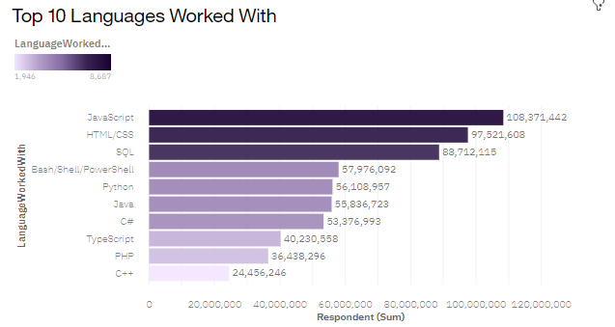
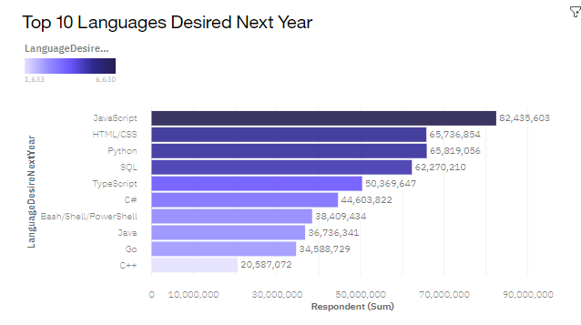
PROGRAMMING LANGUAGE TRENDS
Current Year
Next Year
<Bar chart of top 10 programming languages for the current year goes here.>
< Bar chart of top 10 programming languages for the next year goes here.>

Slide 7
PROGRAMMING LANGUAGE TRENDS - FINDINGS & IMPLICATIONS
Findings
Javascript is and remains the most used programming language
The sums for languages get smaller next year
A lot of languages switch ranks next year
Implications
Javascript is and will remain the most relevant
People are less sure about next years languages than this years
Coding languages are shifting in popularity

Slide 8
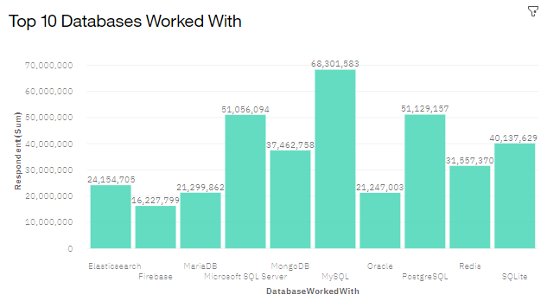
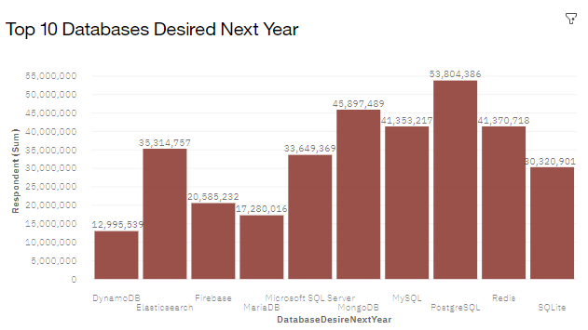
DATABASE TRENDS
Current Year
Next Year
< Bar chart of top 10 databases for the current year goes here >
< Bar chart of top 10 databases for the next year goes here.>

Slide 9
DATABASE TRENDS - FINDINGS & IMPLICATIONS
Findings
MySQL will go from the most popular database to the 4th
All of the databases have an increase in popularity
Some of the lesser popular databases will gain a spot in the top 10
Implications
MySQL will be lose popularity
The need for databases is continuously growing
The popularity of databases is inconsistent and changes each year

Slide 10

DASHBOARD
https://dataplatform.cloud.ibm.com/dashboards/cb7751b6-36a2-482c-8f61-6bd8393bbf84/view/4621c115199b17c751fee6e4079f2b002e637158b5bbd25685d77b490d682397f03c1195c82f1d5ddc125060f3b8150acd

Slide 11
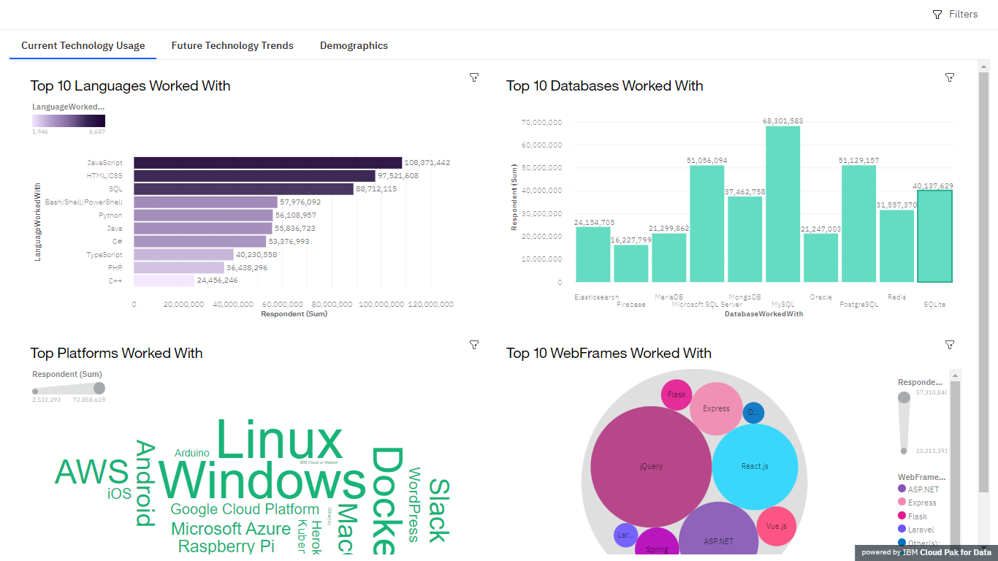
DASHBOARD TAB 1

Slide 12
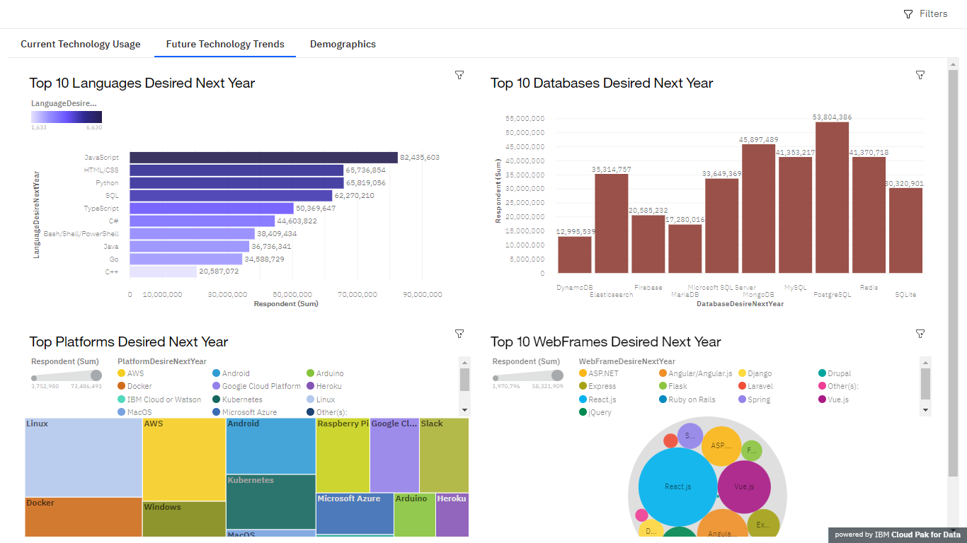
DASHBOARD TAB 2

Slide 13
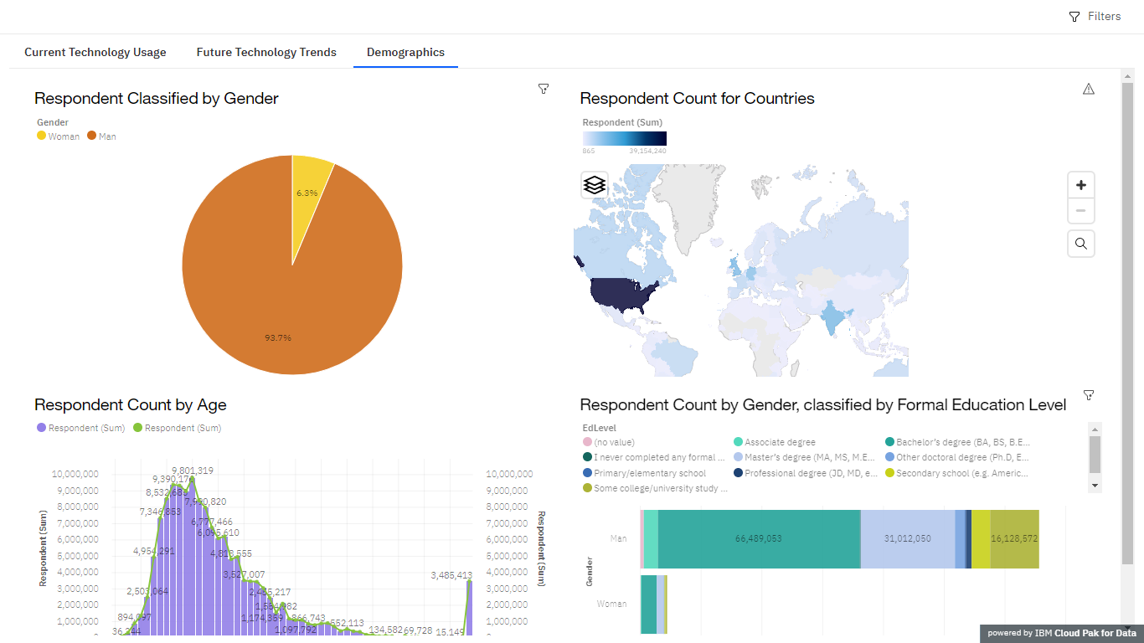
DASHBOARD TAB 3

Slide 14
OVERALL FINDINGS & IMPLICATIONS
Findings
Languages bounce around in popularity, but the top 10 remain
Database popularity changes a lot between now and next year
The majority of this survey data comes from men aged 24-30
Implications
The top ten languages will likely be used consistently for years to come, but will switch ranks
The popularity of certain databases is forever changing as the need for them increases
The majority of people in the field are young adult men

Slide 15

CONCLUSION
Majority of this data comes from men aged 24-30 who are in the majority of the field as well
The top 10 coding languages will remain in the top 10
Databases are becoming increasingly popular
The popularity of individual databases changes frequently and drastically

Slide 16

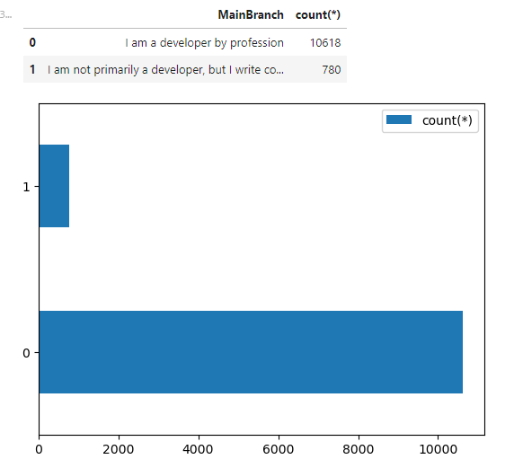
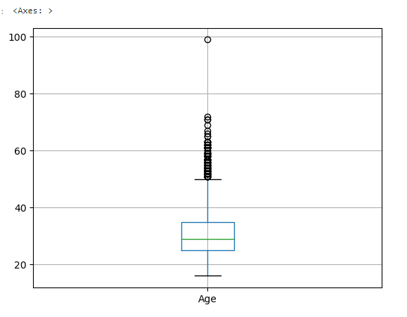
APPENDIX

Slide 17
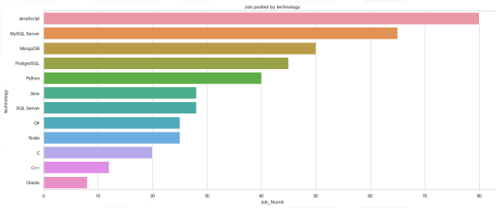
JOB POSTINGS
In Module 1 you have collected the job posting data using Job API in a file named “job-postings.xlsx”. Present that data using a bar chart here. Order the bar chart in the descending order of the number of job postings.

Slide 18
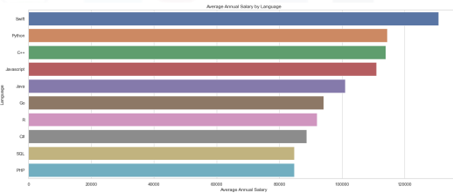
POPULAR LANGUAGES
In Module 1 you have collected the job postings data using web scraping in a file named “popular-languages.csv”. Present that data using a bar chart here. Order the bar chart in the descending order of salary.

